Slide 1
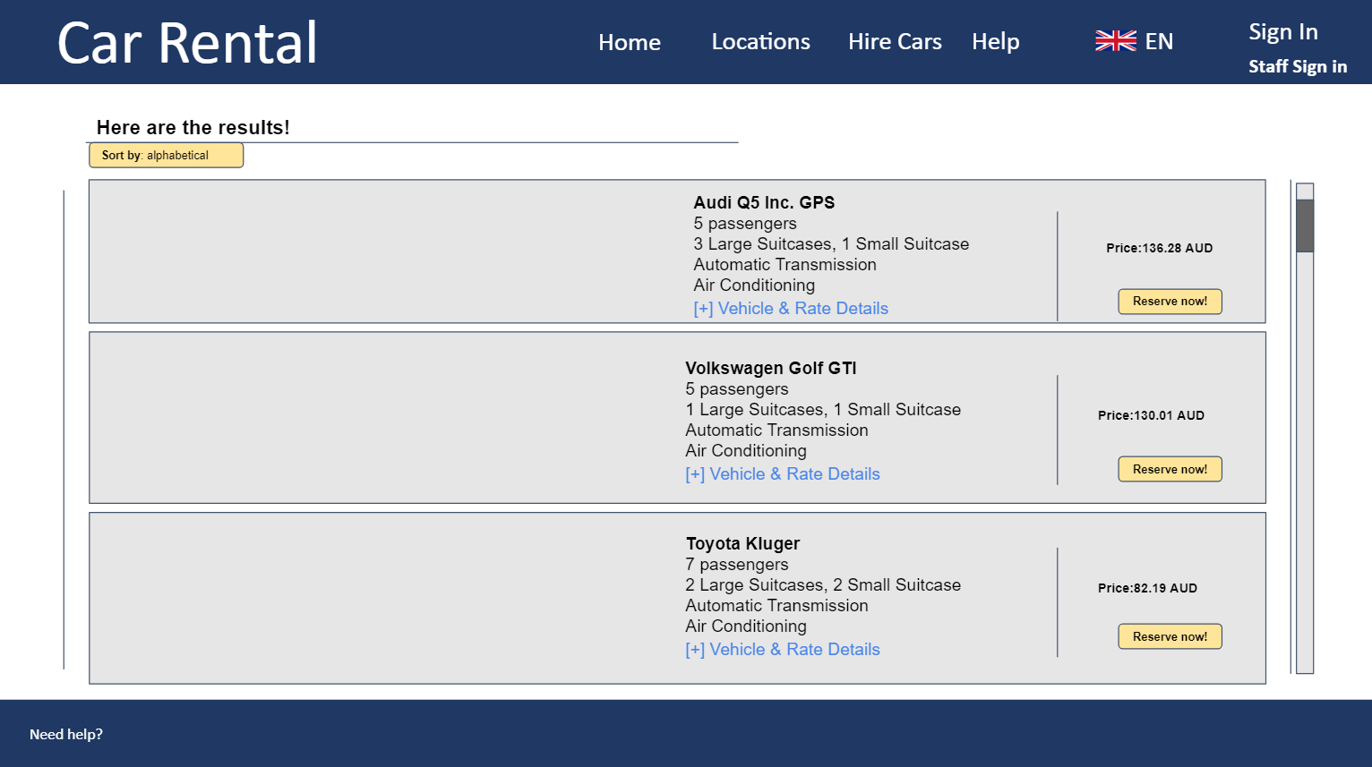
Notes:
The results shown on this page is based on the customers inputs, e.g. date and location

